Slide 1
Coral species and their geographical distribution
Danielle Crowley & Tessel Lagerwerf

Slide 2
Our Plan
Extract the deep sea coral data from NOAA website
Capture certain information:
Scientific name P_dalli
Sample ID EA23453
Data from 2005 onwards If too many? Only from 2010
Type of coral Stony, sponge etc.
Co-ordinates
Depth Those averaged displayed with ±

Slide 3

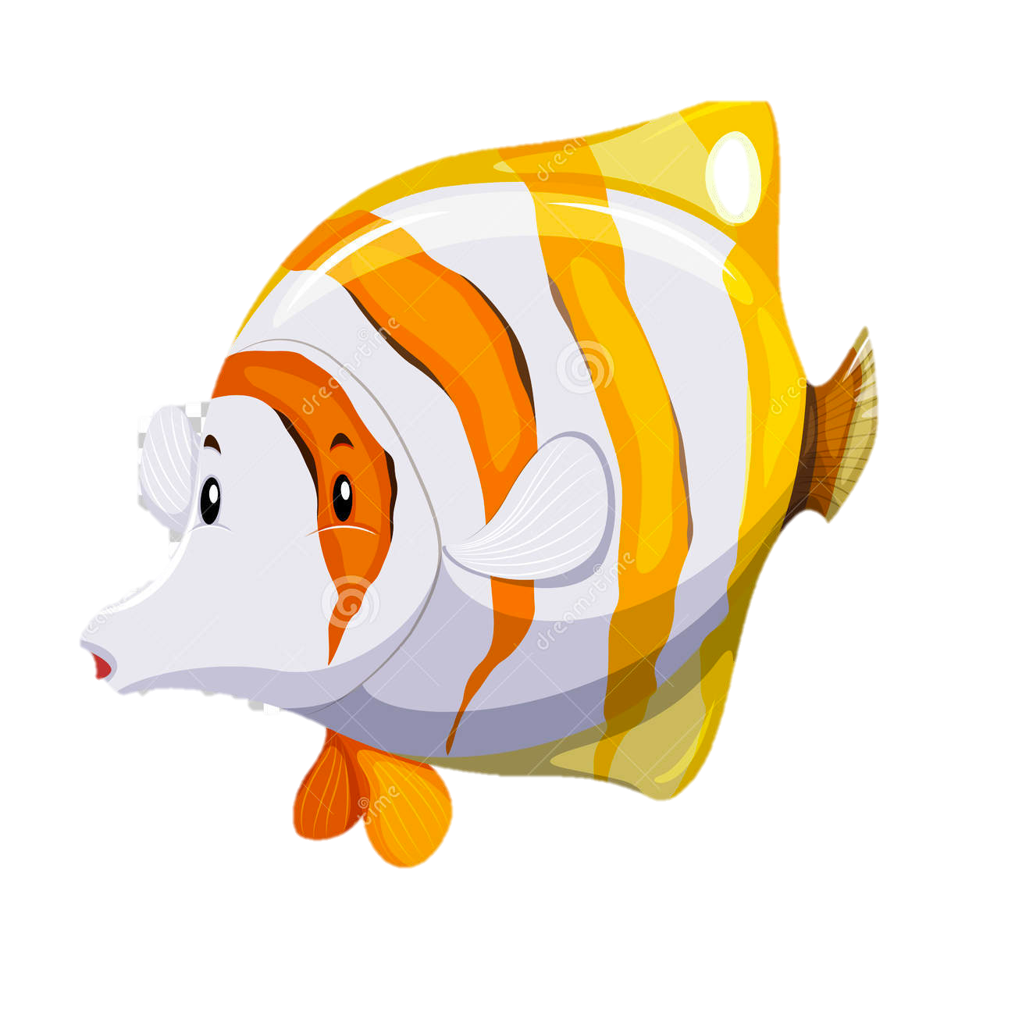
How to create it?
Use a “curl” command to obtain data from the NOAA website
Extract the desired information using regular expression
Run “if” statements to make the program accessible
Create dictionaries within ‘if’ to store the information
Group all species found within a certain area
Using MARMAP in R to create a map

Slide 4

End Goal
To have created a program that:
Can group specific information from data files
Can produce an abundance map with different colours dependant on spp. density
Can be executed across different programs

